Slide 1
PSSA REVIEW!!

Slide 2
Elements
of Fiction

Slide 3
CONFLICT
The _________ in the story
problem

Slide 4
SETTING
_________and _______the story takes place.
Where
when

Slide 5
CHARACTERS
___________, animals, or other creatures that play a role in the _________.
People
story

Slide 6
PLOT
The way the story ______________.
develops

Slide 7
Author’s Purpose
inform
To _________ – author includes facts, statistics, and details
To _________ – author tries to convince the reader of his or her point of view
persuade

Slide 8
Author’s Purpose
entertain
To ___________ – author uses humor, suspense, or exciting language
To ________ – author provides personal comments about the meaning of an experience
reflect

Slide 9
Types of CONFLICT
_______ Conflict:
a struggle between two characters or between a character and an outside force.
External
character
Character vs. ____________
Character vs. ____________
Character vs. ____________
nature
society

Slide 10
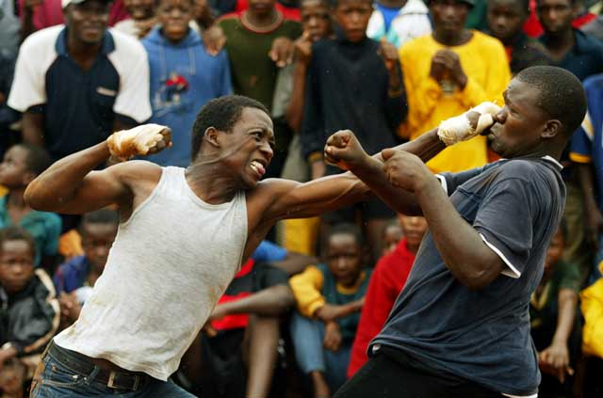
Character vs. Character

Slide 11
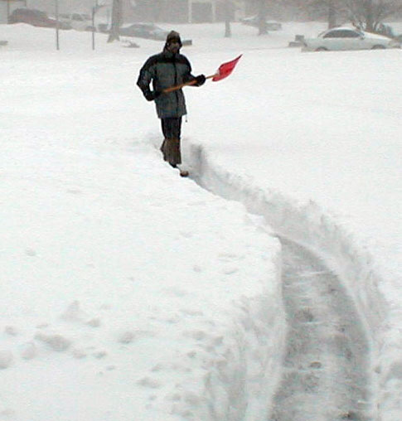
Character vs. Nature

Slide 12
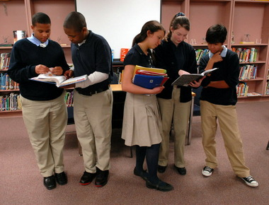
Character vs. Society

Slide 13
Types of CONFLICT
_______ Conflict:
a struggle within the mind of a character
Internal

Slide 14
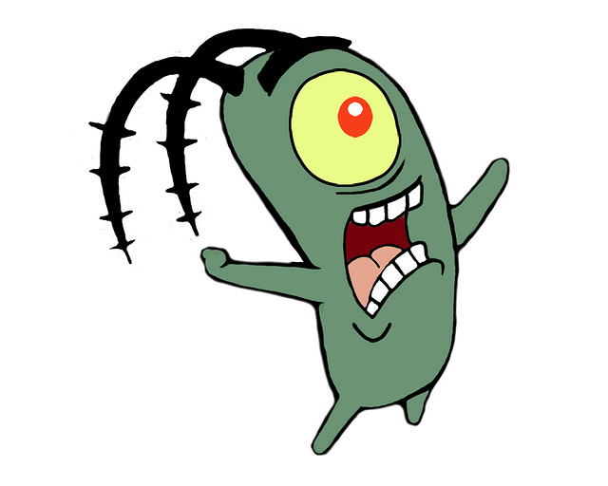
Characters
Protagonist –
the ________ character
main
Antagonist –
the character or force that is in ___________ with the protagonist
conflict

Slide 15
CLIMAX
The most _____________moment in the plot, when the ___________is most intense.
exciting
conflict
RISING ACTION
Introduces the story’s main ______________.
FALLING ACTION
Everything that happens ___________the climax.
conflict
after
EXPOSITION
The _____________of the story. Characters and _________are introduced.
RESOLUTION
The ________of the story, when the conflict is ____________.
beginning
end
setting
resolved

Slide 16
Flashback
__________________ - a scene in a narrative that takes the reader back in time to an event that happened before the story began
__________________ - use of clues to hint at an event that will occur later in the narrative
Foreshadowing

Slide 17
Irony – a contrast or contradiction between appearance and _____________, between what was expected and what actually _____________, or between meaning and _______________.
reality
happened
intention
Verbal
Situational
Dramatic
___________ Irony
a writer or character says something that is the opposite of what that person really means
__________ Irony something happens that contradicts what the reader, a character, or the audience expects to happen
___________ Irony
the reader or audience knows something that a character does not

Slide 18
Types of NonFiction
NARRATIVE - writing that tells a ______ story (biography, autobiography)
EXPOSITORY – writing that gives __________ about a topic (news articles, encyclopedias)
PERSUASIVE – writing that tries to _________the reader to agree with a certain point of view (speeches)
REFLECTIVE – writing in which the author _________
about certain ideas or experiences (journals, diaries)
true
information
convince
thinks

Slide 19
FACT
Something that you can ________. It actually exists.
Example: The sky is blue.
prove
OPINION
Something you cannot prove.
It is based on beliefs or ___________.
Example: TITANIC is the best movie ever!
feelings

Slide 20
TONE the author’s _______________ toward his or her subject. (Can usually be summarized by a single word.)
attitude

Slide 21
Types of Organization
CAUSE-AND-EFFECT
________or ________ something happened
CHRONOLOGICAL
Arranges events by proper _________ in ________
COMPARE-AND-CONTRAST
Shows how two or more subjects are the _________ and different
PROBLEM-AND-SOLUTION
Identifies an issue and provides a ____________
why
how
order
time
same
resolution

Slide 22
SIMILE
SIMILE
Uses _______ or _______ to compare two different things.
like
as

Slide 23
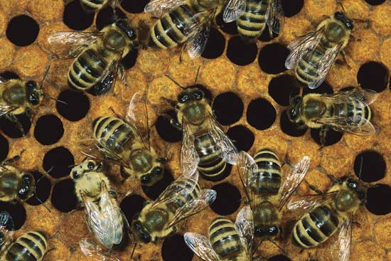
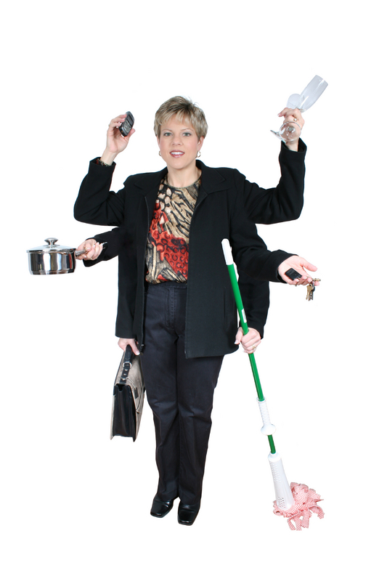
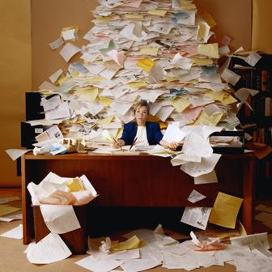
Busy as a bee

Slide 24
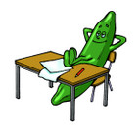
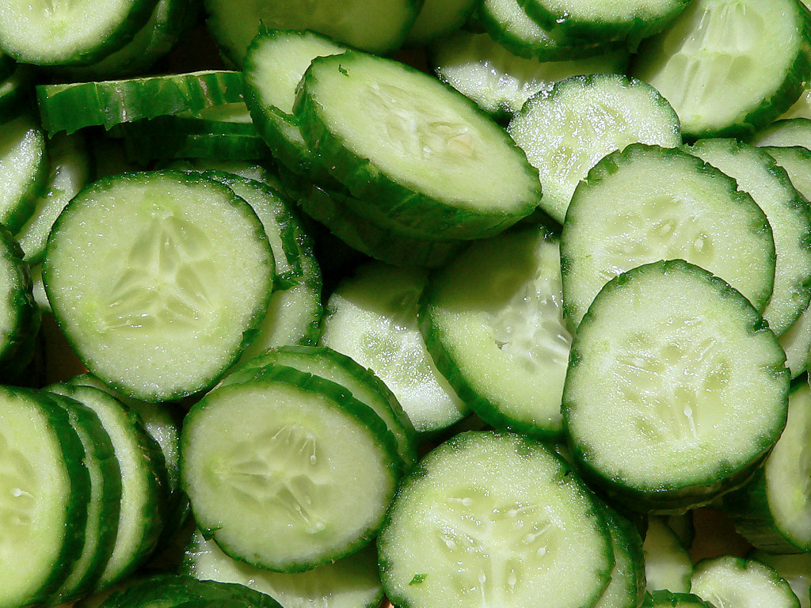
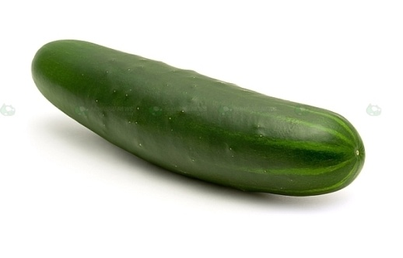
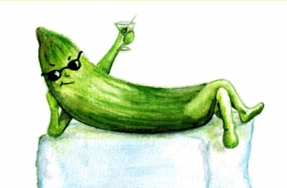
Cool as a cucumber

Slide 25
METAPHOR
METAPHOR
Describes one thing as if it were _____________, without using like or as
another

Slide 26
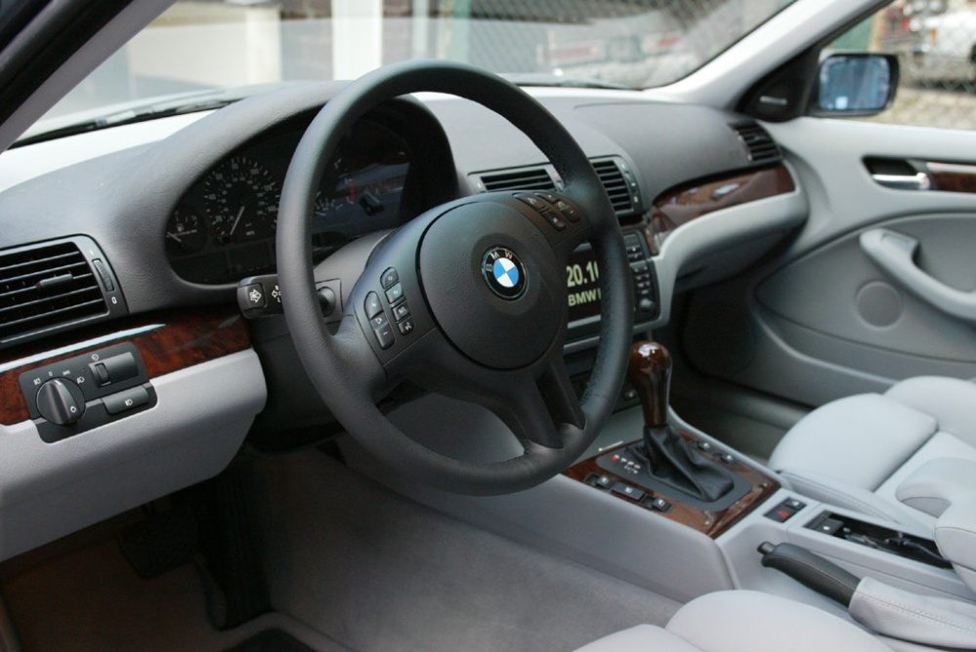
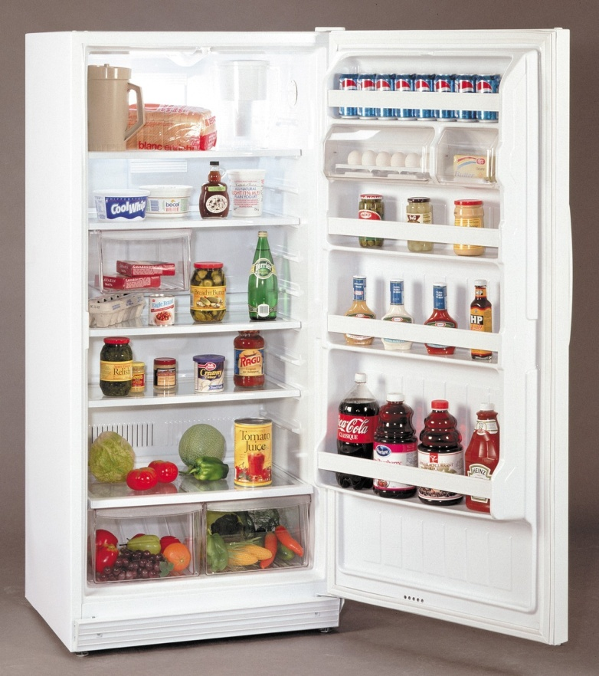
The inside of the car was a refrigerator.
The inside of the
car was very cold.

Slide 27
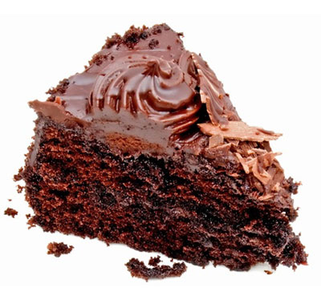
The test was a piece of cake.
The test was very easy.

Slide 28
PERSONIFICATION
PERSONIFICATION
Giving _________qualities to something ________________.
human
nonhuman

Slide 29
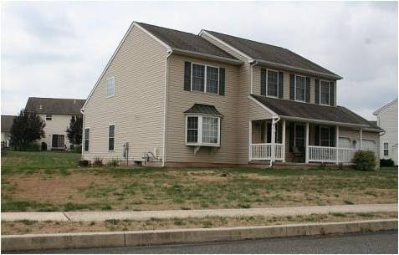
The brown grass
begged for water.

Slide 30
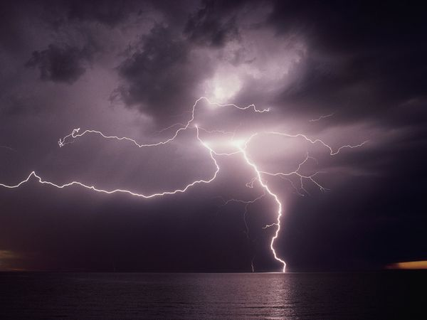
Lightning danced across the sky.

Slide 31
HYPERBOLE
HYPERBOLE
______________
speech for emphasis.
exagerrates

Slide 32
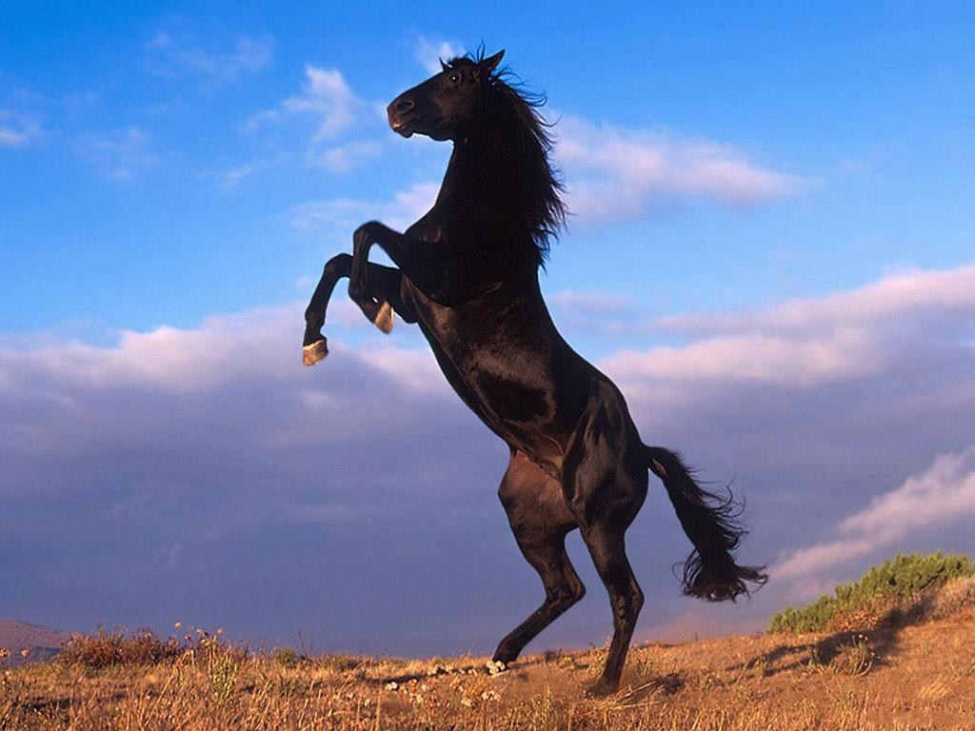
I’m so hungry I could eat a horse!

Slide 33
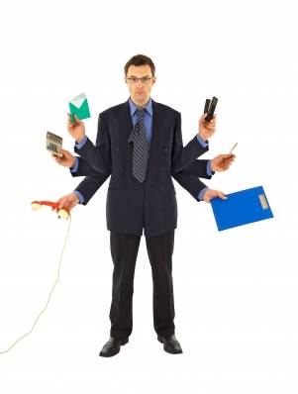
I have a million things to do.

Slide 34
Imagery
Language that appeals
to one or more of the
five __________.
senses
Mood
The overall _________
of a passage.
feeling

Slide 35
SOUND DEVICES:
Alliteration – the repetition of ___________ sounds at the ________________ of words
Consonance – the ______________ of consonant sounds at the _________ of words
Assonance – the repetition of ____________ sounds in words
Onomatopoeia – the use of a word that _______________ like what it means
consonant
beginning
repetition
end
vowel
sounds

Slide 36
BASIC PARTS OF SPEECH
Noun – a person, __________, or thing
The young girl happily walked to the new park with her brown dog.
Pronoun – a word that takes the __________ of a noun
The young girl happily walked to the new park with her brown dog.
Verb – expresses ___________ or being
The young girl happily walked to the new park with her brown dog.
Adjective – a word that _____________ a noun or a pronoun
The young girl happily walked to the new park with her brown dog.
Adverb – a word that _____________ a verb
The young girl happily walked to the new park with her brown dog.
place
place
action
describes
describes

